Slide 1


ACCIDENTS UNDERCOVERD:FACTORS BEHINED ROAD CRASHES
CAPSTONE PROJECT
EMAN ALJOWAIR

Slide 2

CONTENT
1
INTRODUCTION
4
ROAD DESIGN & INFRASTRUCTURE
2
TEMPORAL FACTORS
5
VISIBILITY CONDITIONS
3
ENVIRONMENTAL CONDITIONS
6
RECOMMENDATONS

Slide 3
INTRODUCTION
Road accidents claim over 1.3 million lives globally each year — that’s one person every 24 seconds.
This analysis is based on UK accident data collected over a two-year period, aiming to uncover meaningful patterns in road safety.

Slide 4
PROBLEM STATMENT
Road traffic accidents are a major public safety concern, leading to loss of life, injuries, and economic burdens.
This Analysis of road accident data can help identify patterns, contributing factors, and high-risk areas, enabling road safety improvement by engineers and policymakers and reducing accidents rate.

Slide 5
INTRODUCTION
UNDERSTANDING HOW WE MEASURE ACCIDENT SEVERITY
Metric | What It Measures | How It's Calculated | Interpretation
Fatality Rate | How deadly accidents are | Number of deaths ÷ Number of accidents | Higher rate = more crashes result in death
Average Severity | Overall seriousness of accidents (injuries + deaths) | Assign scores: Slight = 1, Serious = 2, Fatal = 3 → Then average the scores | Higher score = more severe crashes

Slide 6
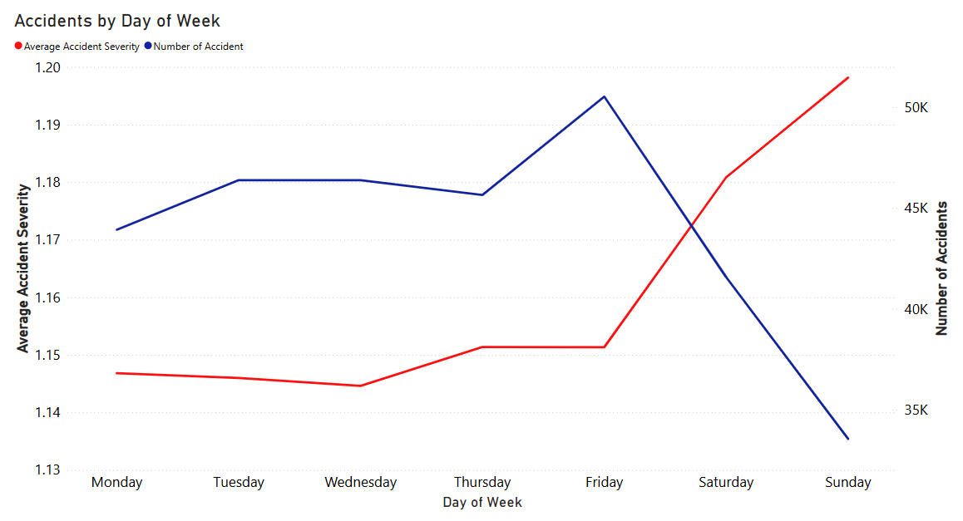
TEMPORAL FACTORS: DAY OF WEEK

Slide 7
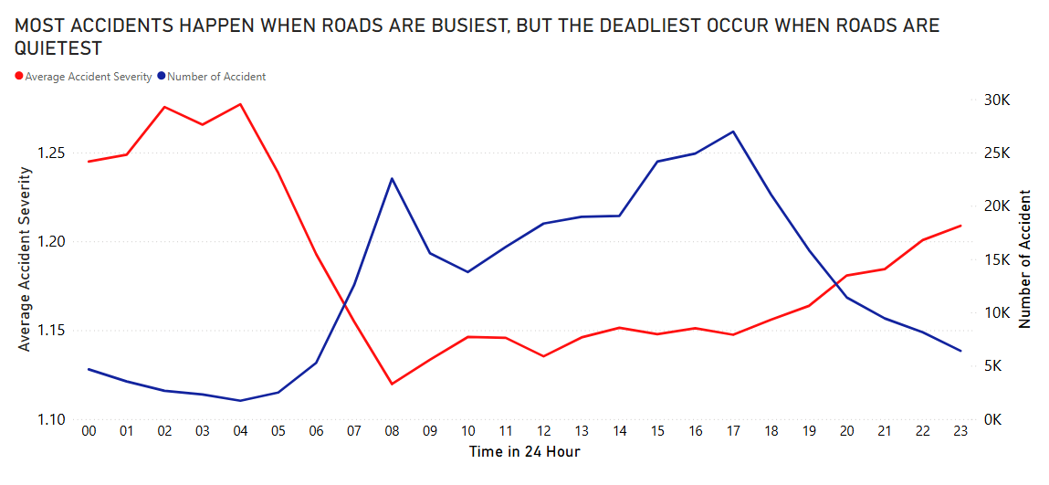
TEMPORAL FACTORS: HOUR OF DAY
Summer Sunrise
Winter Sunrise

Slide 8
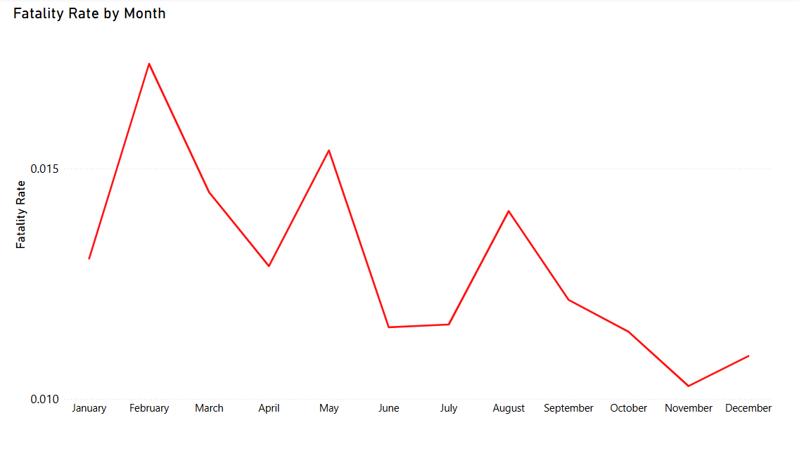
TEMPORAL FACTORS: MONTH AND SEASON
Winter
Spring
Summer
Autumn

Slide 9
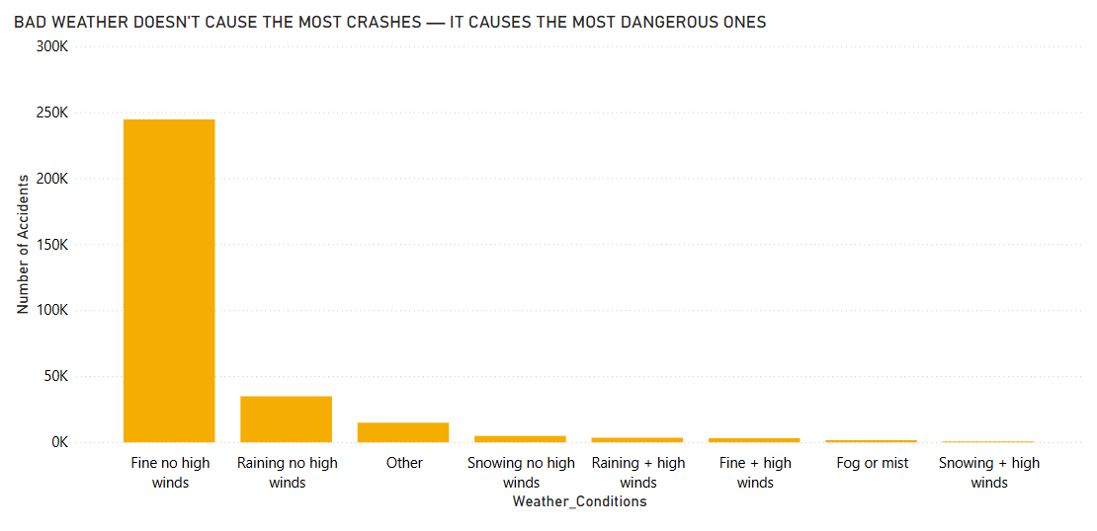
ENVIRONMENTAL CONDITIONS

Slide 10
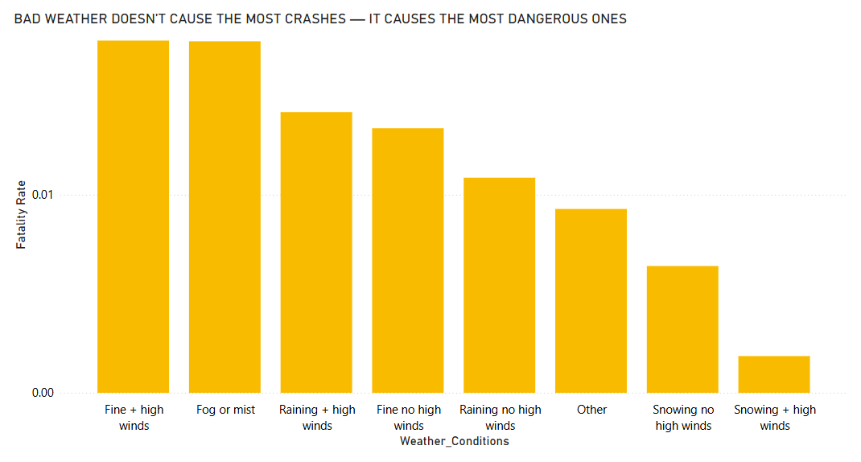
ENVIRONMENTAL CONDITIONS

Slide 11
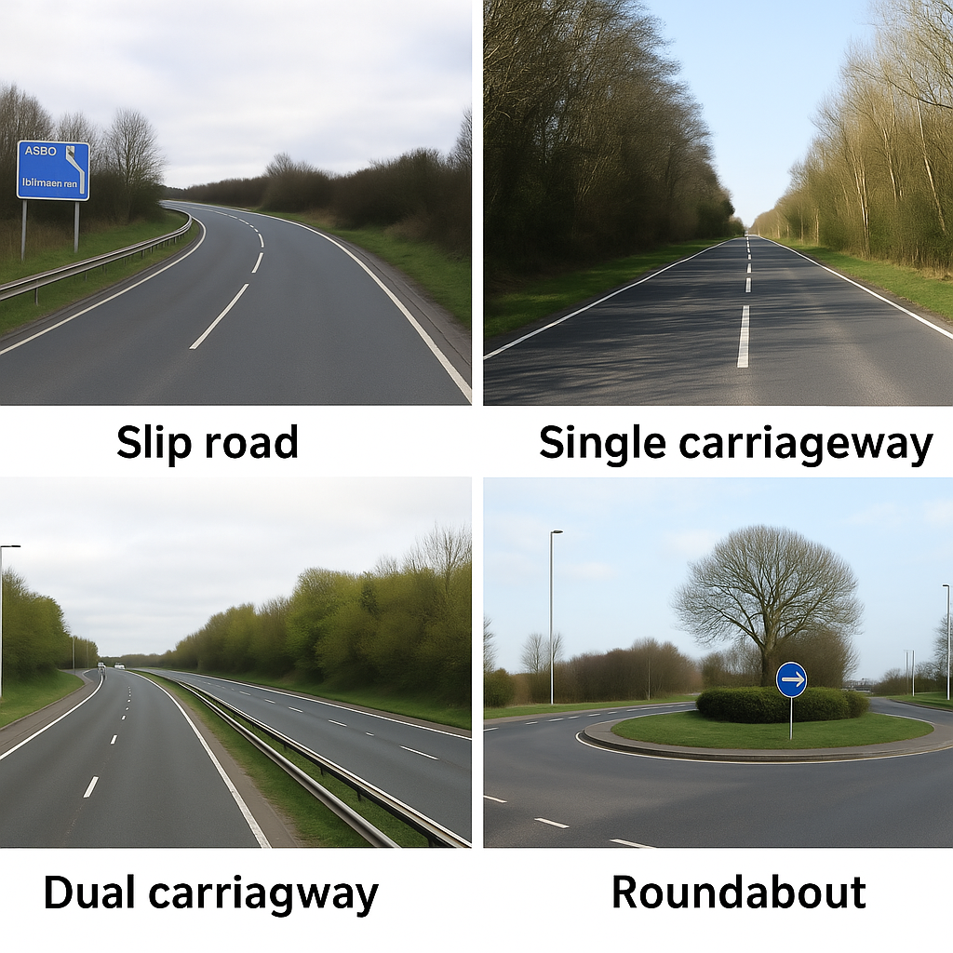
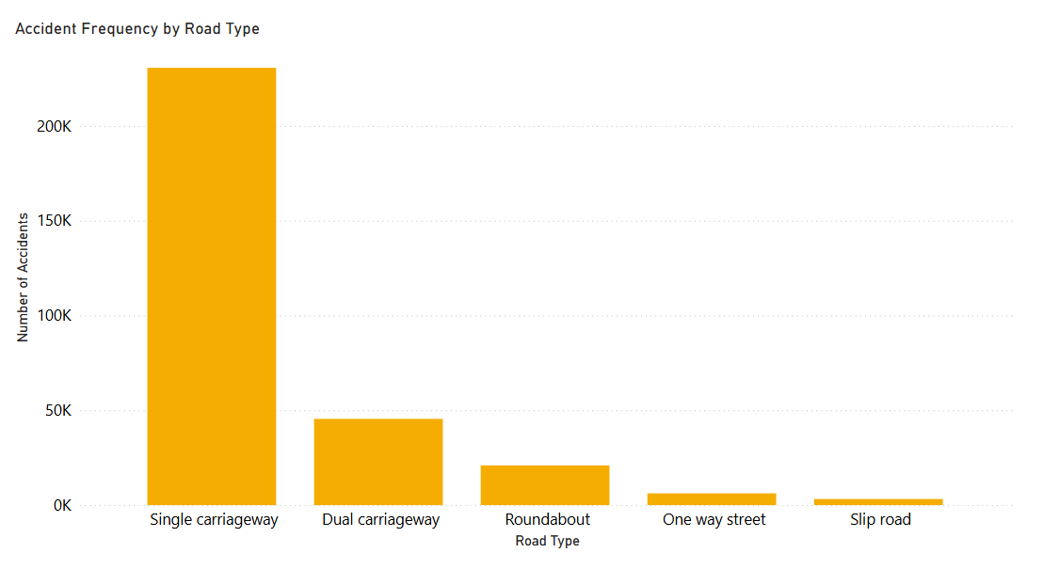
ROAD DESIGN & INFRASTRUCTURE:
ROAD TYPE
Dual Carriageway
Singal Carriageway
Slip Road

Slide 12
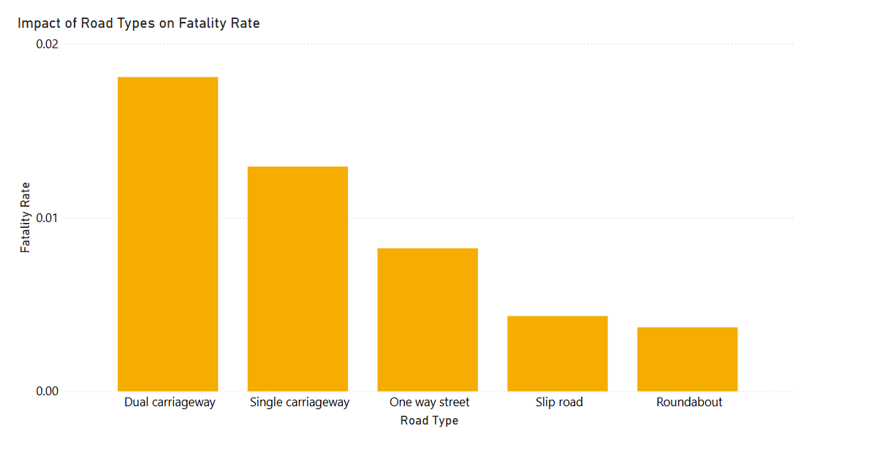
ROAD DESIGN & INFRASTRUCTURE:
ROAD TYPE
Dual Carriageway
Singal Carriageway
Slip Road

Slide 13
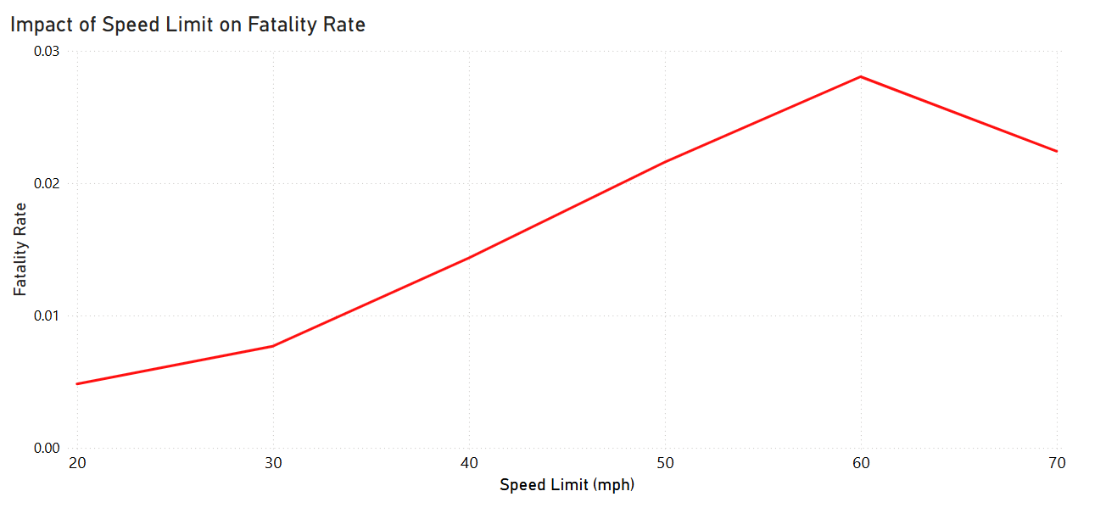
ROAD DESIGN & INFRASTRUCTURE: SPEED LIMIT
60 MPH = 96 KMH
70 MPH = 112 KMH

Slide 14
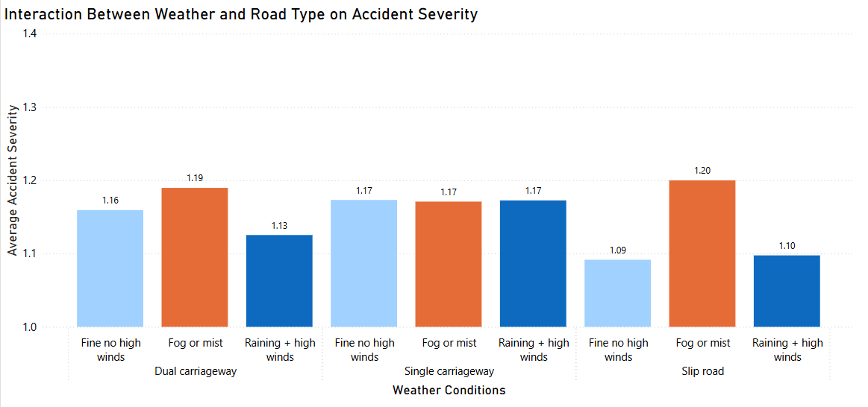
ROAD DESIGN + ENVIRONMENTAL CONDITIONS

Slide 15
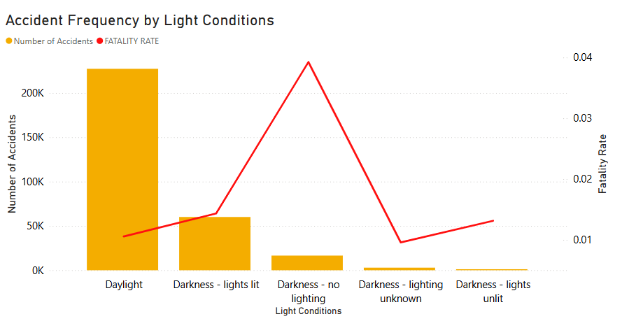
VISIBILITY CONDITIONS

Slide 16
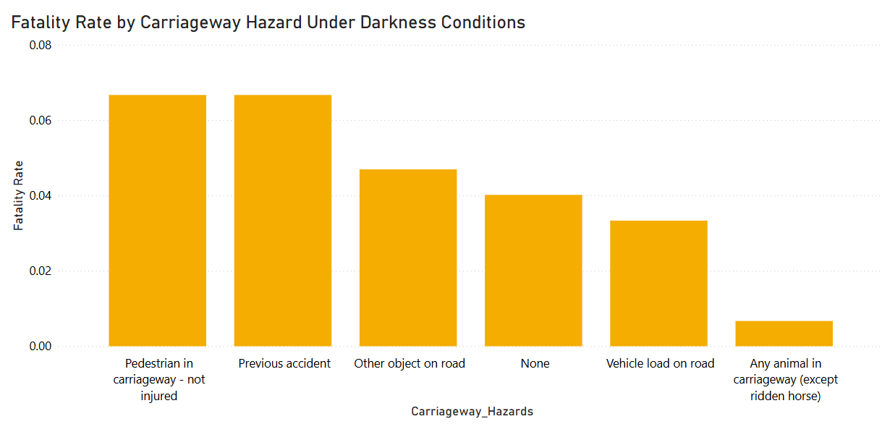
VISIBILITY CONDITIONS

Slide 17

🚦 Accidents are most severe in low-traffic times (night, early morning).
🌧 Fog and high winds drastically increase fatality risk.
🌧 Snow is less deadly — possibly due to reduced travel or road closures.
🛣 Road design plays a critical role in accident outcomes.
💡 Most accidents occur during daylight, but fatality rates spike in complete darkness.
KEY
FINDINGS

Slide 18
🚦 Improve Safety in High-Risk Timeframes
Increase traffic awareness during early morning and late-night hours, when fatal accidents are most likely.
🌧 Enhance Driver Awareness During Hazardous Weather
Encourage use of headlights, fog lights, and safe driving distances during poor visibility.
🛣 Redesign High-Risk Road Types.
💡 Improve Road Lighting and Visibility
Install or upgrade street lighting, especially in areas with a history of severe night-time accidents.
RECOMENDATIONS

Slide 19
THANK YOU

